Slide 1


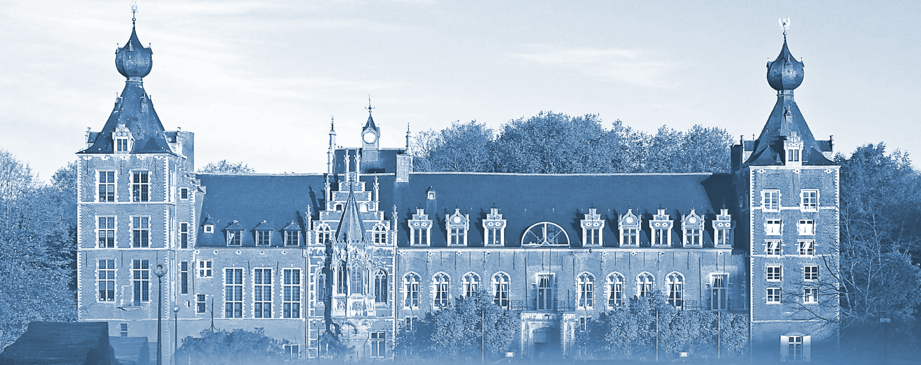
Pose Guided Person Image Generation
Liqian Ma¹, Xu Jia^{2∗}, Qianru Sun^{3∗}, Bernt Schiele³, Tinne Tuytelaars², Luc Van Gool^{1,4}
¹KU-Leuven/PSI, TRACE (Toyota Res in Europe) ²KU-Leuven/PSI, IMEC
³Max Planck Institute for Informatics, Saarland Informatics Campus ⁴ETH Zurich
Accepted at NIPS 2017
Notes:
The title of our NIPS paper is “Pose Guided Person Image Generation”

Slide 2

Outline
Problem Statement.
Related Work.
Method.
Experiments.
Conclusions.
Notes:
During the next fifteen minutes, I will introduce our paper from the following 5 aspects

Slide 3
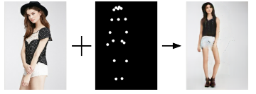
Problem Statement
Task: Synthesize person images in arbitrary poses, based on an image of that person and a novel pose.
Motivation: Provide users more control over the generation process.
Key idea: Guide the generation process explicitly by an appropriate representation of that intention.
Condition Image
Target Pose
Generated Image
Notes:
The first is our problem statement. We propose a new task called “pose guided person image generation”. The goal is to synthesize person image based on condition image and target pose.

Slide 4
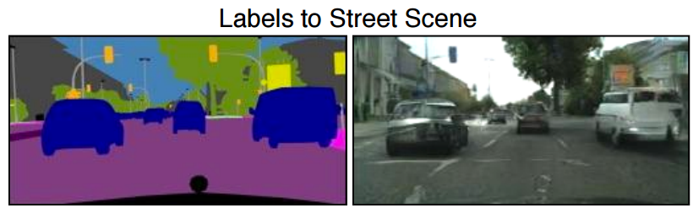
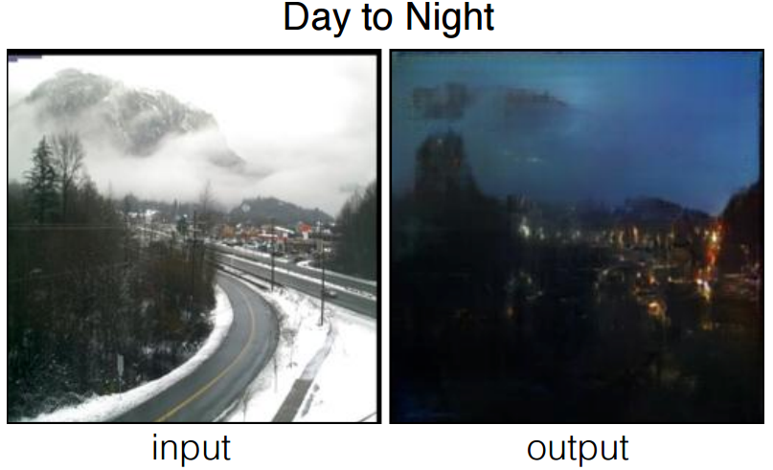
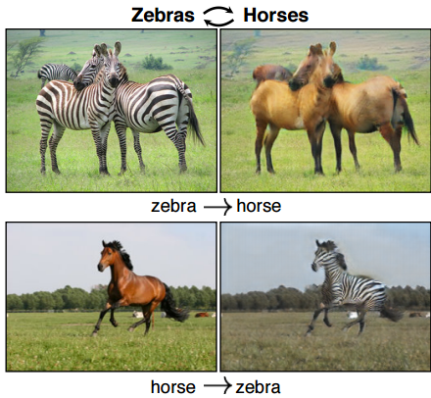
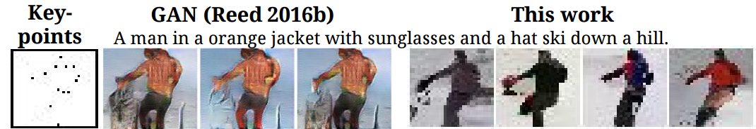
Related Work
Image --> Image
CycleGAN - ICCV 2017
GAN - CVPR 2017
CVPR 2017, Image-to-Image Translation with Conditional Adversarial Networks
ICCV 2017, Unpaired Image-to-Image Translation using Cycle-Consistent Adversarial Networks
Text + Keypoint --> Image
GAN - NIPS 2016
PixelCNN - ICLRw 2017
NIPS 2016, Learning What and Where to Draw
ICLRw, 2017GENERATING INTERPRETABLE IMAGES WITH CONTROLLABLE STRUCTURE
Notes:
One related work is the img2img translation to transfer the style of the image. The images are aligned in spatial space.
Another related work is the image generation based on keypoints and text. The appearance information is then from text implicitly.

Slide 5
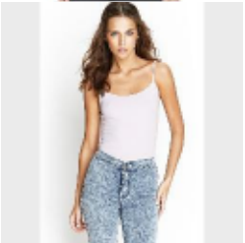
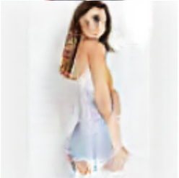
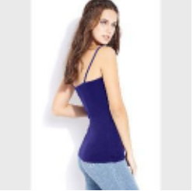
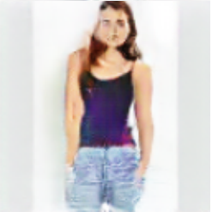
Related Work
Image + Viewpoint --> Image
view
view
view
VariGAN - Arxiv 2017
Arxiv 2017, Multi-View Image Generation from a Single-View
Our work
More concrete appearance and structure information
Condition Image
Target Pose
Generated Image
Notes:
The most related work is the VariGAN to translate the person image based on the view feature.
Different from this, our work tries to translate the person pose explicitly based on pose keypoint

Slide 6



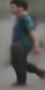
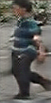
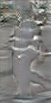
Method
Our Two-stage Framework
concat
coarse
result
skip connection
...
...
Condition
image
Target
pose
Target
image
Condition
image
Generator at Stage-I (G1)
Real
or
Fake
Real pair
skip connection
difference map
Discriminator (D) at Stage-II
concat
refined
result
Condition
image
Condition
image
Generator at Stage-II (G2)
Fake pair
The overall framework of our Pose Guided Person Generation Network (PG2).
It contains two stages focusing on pose and appearance, respectively.
Notes:
We use the divide and conquer strategy to design our two stages

Slide 7
Method
Our Two-stage Framework
concat
coarse
result
skip connection
...
...
Condition
image
Target
pose
Target
image
Condition
image
Generator at Stage-I (G1)
Real
or
Fake
Real pair
skip connection
difference map
Discriminator (D) at Stage-II
concat
refined
result
Condition
image
Condition
image
Generator at Stage-II (G2)
Fake pair
Stage-I focuses on pose integration and generates an initial result that captures the global structure of the human.
Notes:
We focus on the global structure.
Concatenate the condition image and target pose and input them into a u-net like architecture to get the coarse result

Slide 8
Method
Our Two-stage Framework
concat
coarse
result
skip connection
...
...
Condition
image
Target
pose
Target
image
Condition
image
Generator at Stage-I (G1)
Real
or
Fake
Real pair
skip connection
difference map
Discriminator (D) at Stage-II
concat
refined
result
Condition
image
Condition
image
Generator at Stage-II (G2)
Fake pair
Stage-II focuses on refining the initial result via adversarial training and generates sharper images.
Notes:
We focus on appearance details. We show the condition image to the network again and concatenate it with the coarse result to generate the different map. Then get the refined result. The second stage is trained adversarially to make the appearance more realistic.

Slide 9
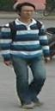



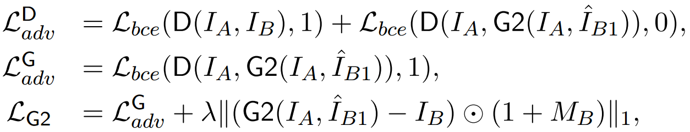
Method
Optimization losses
Target
image
Target
pose
Pose skeleton
Pose mask
pose keypoints
estimation
pose keypoints connection
morphological
operations
Process of computing the pose mask
Stage-I:
Stage-II:
Notes:
Besides, we want the network focus on the foreground rather than the background, since the backgrounds of the condition and target image are usually different.
We propose a pose maks loss. We first extract the mask from pose keypoint, then apply it to the losses. Closing is reverse of Opening, Dilation followed by Erosion

Slide 10
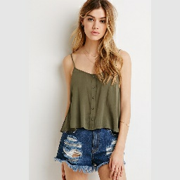
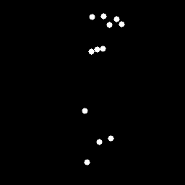
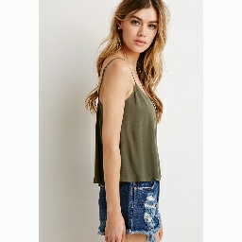
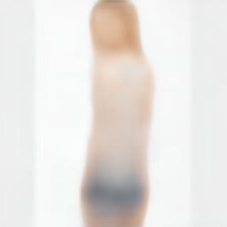
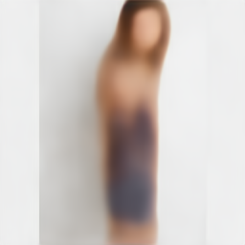
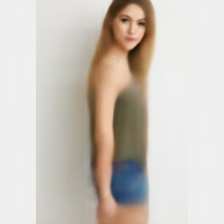
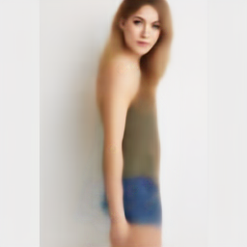
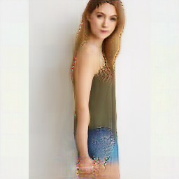
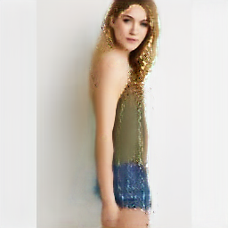
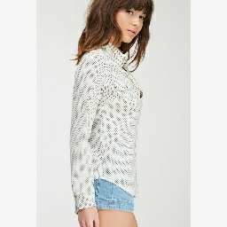
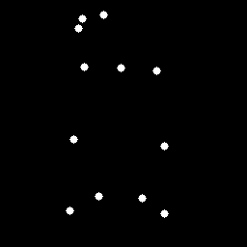
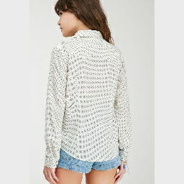
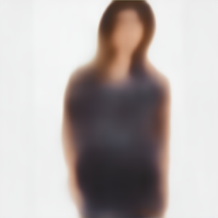

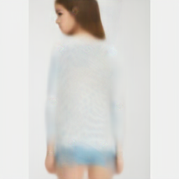
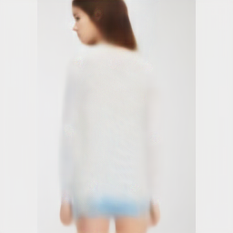
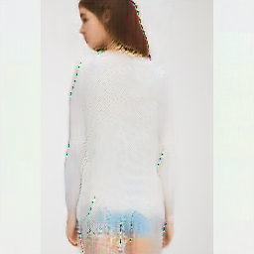


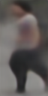
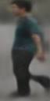
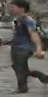

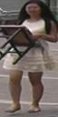

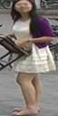


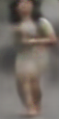
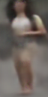
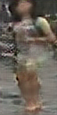
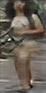
Experiments
The proposed embedding method generates more accurate and realistic results than CE (Coordinate Embedding) and HME (Heat Map Embedding).
Qualitative results
1
2
3
4
5
6
7
8
9
Condition image
Target pose
Target image(GT)
G1-CE-L1
G1-HME-L1
G1-L1
G1-poseMaskLoss
(our coarse result)
G1+D
G1+G2+D
(our refined result)
DeepFashion dataset
Market-1501 dataset
Notes:
‹#›
We compare the proposed pose embedding methods. The explicit way performs best

Slide 11
Experiments
The proposed Posemask loss results in sharper results.
Qualitative results
1
2
3
4
5
6
7
8
9
Condition image
Target pose
Target image(GT)
G1-CE-L1
G1-HME-L1
G1-L1
G1-poseMaskLoss
(our coarse result)
G1+D
G1+G2+D
(our refined result)
Notes:
‹#›
When adding the pose mask loss, the results become sharper.

Slide 12
Experiments
The proposed two-stage framework generate better results than one-stage.
Qualitative results
1
2
3
4
5
6
7
8
9
Condition image
Target pose
Target image(GT)
G1-CE-L1
G1-HME-L1
G1-L1
G1-poseMaskLoss
(our coarse result)
G1+D
G1+G2+D
(our refined result)
Sharper arm
and face
More texture
More texture and
background details
Sharper legs and
more object details
Notes:
‹#›
When use our two stage framework, more details are added.

Slide 13
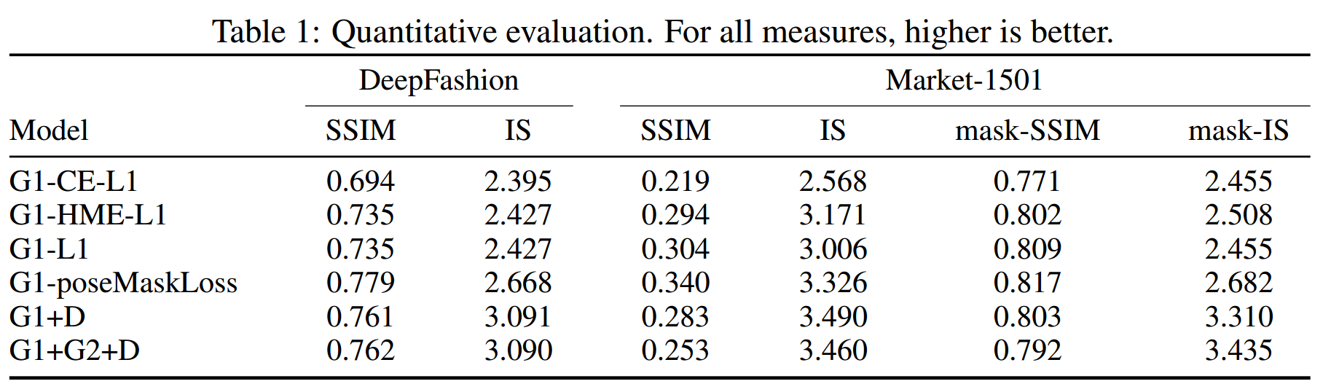
Experiments
Quantitative results
Notes:
We use mask-SSIM and mask-IS to reduce the influence of background on Market-1501.
Blurry image may have slightly higher SSIM.
Notes:
‹#›
For quantitative results, our two stage framework performs better on both dataset

Slide 14
Experiments
Quantitative results
The proposed pose embedding (G1-L1) consistently outperforms G1-CE-L1 across all measures and both datasets. G1-HME-L1 obtains similar quantitative numbers probably due to the similarity of the two embeddings.
Changing the loss from L1 to the proposed poseMaskLoss (G1-poseMaskLoss) consistently improves further across all measures and for both datasets.
Adding the discriminator during training either after the first stage (G1+D) or in our full model (G1+G2+D) leads to comparable numbers, even though we have observed clear differences in the qualitative results as discussed above. This is explained by the fact that blurry images often get good SSIM despite being less convincing and photo-realistic.
Note: mask-SSIM and mask-IS to reduce the influence of background on Market-1501 dataset.
Notes:
‹#›

Slide 15
Experiments
Quantitative results
The proposed pose embedding (G1-L1) consistently outperforms G1-CE-L1 across all measures and both datasets. G1-HME-L1 obtains similar quantitative numbers probably due to the similarity of the two embeddings.
Changing the loss from L1 to the proposed poseMaskLoss (G1-poseMaskLoss) consistently improves further across all measures and for both datasets.
Adding the discriminator during training either after the first stage (G1+D) or in our full model (G1+G2+D) leads to comparable numbers, even though we have observed clear differences in the qualitative results as discussed above. This is explained by the fact that blurry images often get good SSIM despite being less convincing and photo-realistic.
Note: mask-SSIM and mask-IS to reduce the influence of background on Market-1501 dataset.
Notes:
‹#›

Slide 16
Experiments
Quantitative results
The proposed pose embedding (G1-L1) consistently outperforms G1-CE-L1 across all measures and both datasets. G1-HME-L1 obtains similar quantitative numbers probably due to the similarity of the two embeddings.
Changing the loss from L1 to the proposed poseMaskLoss (G1-poseMaskLoss) consistently improves further across all measures and for both datasets.
Adding the discriminator during training either after the first stage (G1+D) or in our full model (G1+G2+D) leads to comparable numbers, even though we have observed clear differences in the qualitative results as discussed above. This is explained by the fact that blurry images often get good SSIM despite being less convincing and photo-realistic.
Note: mask-SSIM and mask-IS to reduce the influence of background on Market-1501 dataset.
Notes:
‹#›

Slide 17
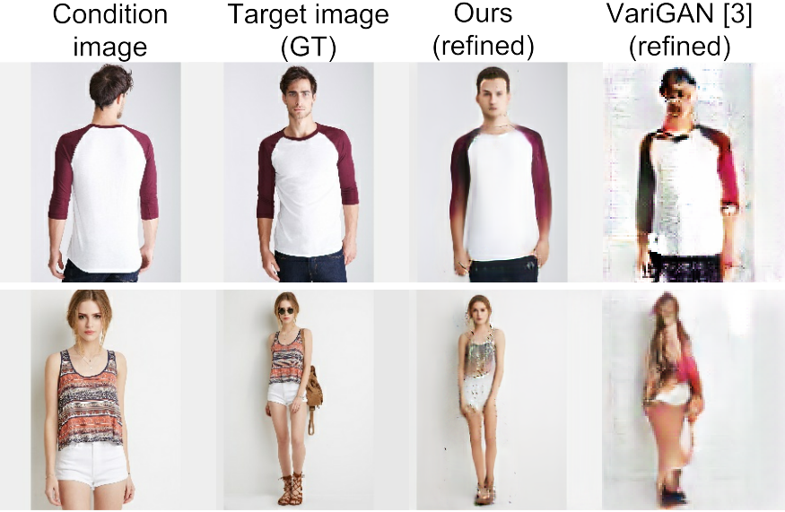
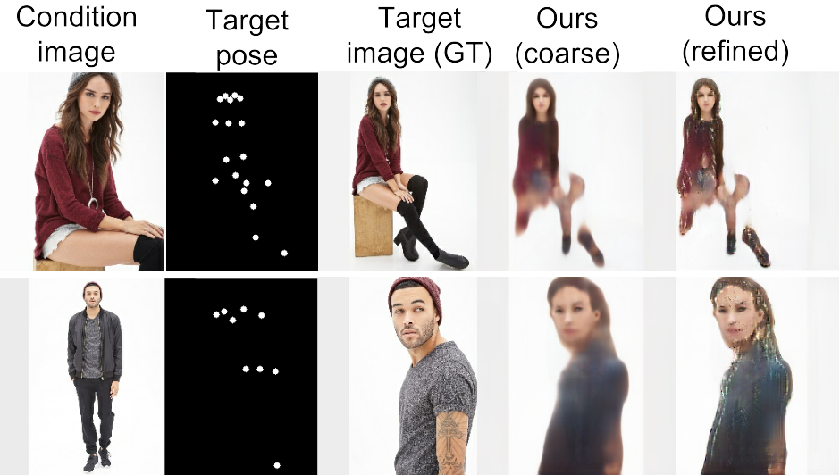
Experiments
Further analysis
Comparison to VariGAN
Failure cases on DeepFashion
More realistic results, especially the faces.
Generate whole body from half body.
Rare data for some specific poses.
Rare data for male.

Slide 18

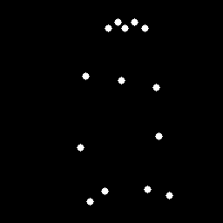

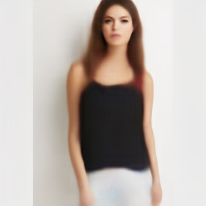
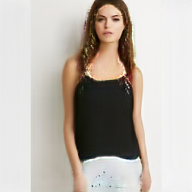
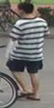

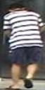
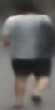
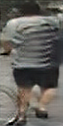





























Experiments
Condition
image
Target
pose
Target
image (GT)
Coarse
result
Refined
result
Condition
image
Target
pose
Target
image (GT)
Coarse
result
Refined
result
Condition image
Target pose sequence
Refined results
Generate whole body from up body
Generate front view from side view

Slide 19

Experiments
Influence of
λ
smaller λ leads to more details and sharper images (except λ = 0)
larger λ leads to less details and blurrier images

Slide 20
Conclusions
Contributions
We propose a novel task of conditioning image generation on a reference image and an intended pose.
We propose a two stages framework focusing on global body structure and local appearance details.
Our method can be useful for several tasks (see Further Reading).
Further Reading
Person re-identification
A Pose-Sensitive Embedding for Person Re-Identification with Expanded Cross Neighborhood Re-Ranking
Pose-Normalized Image Generation for Person Re-identification
Disentangled Person Image Generation
Video Prediction
Deep Video Generation, Prediction and Completion of Human Action Sequences
Face generation
Natural and Effective Obfuscation by Head Inpainting
Every Smile is Unique: Landmark-Guided Diverse Smile Generation

Slide 21
Questions ?

